Slide 1
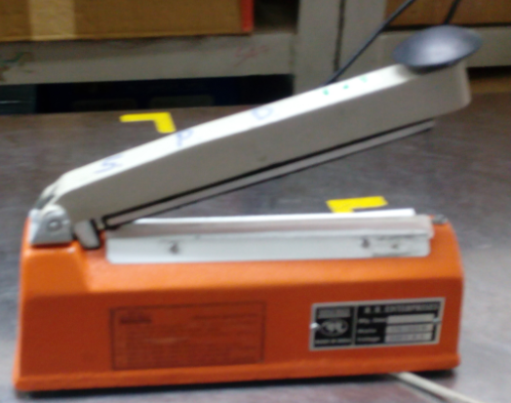
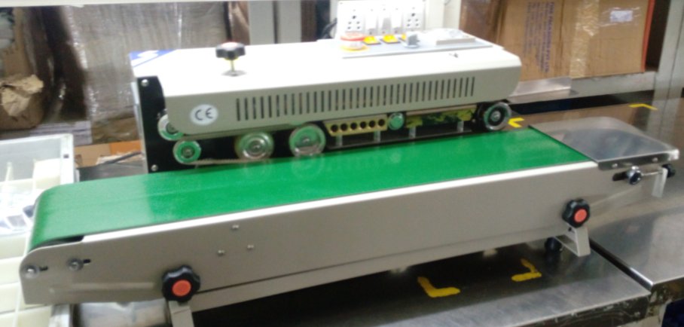
P15
TPM CIRCLE NO :- 01
ACTIVITY
KK
QM
PM
JH
SHE
OT
DM
E&T
KAIZEN IDEA SHEET
TPM CIRCLE NAME:
LOSS NO. / STEP
DEPT :- DISPATCH
RESULT AREA
P
Q
A
C
D
S
M
CELL:-SPD
CELL NAME:- SPD Packing
MACHINE / STAGE :- SPD Packing
OPERATION :- SPD Packing
KAIZEN THEME : To Reduce cycle time for SPD Packing
IDEA :-To Purchased new Auto sealing machine.
Problem present status :-SPD Line Sealing Operation was manual by using 02 manpower with .20 sec cycle time.
COUNTERMEASURE:-
New Auto sealing machine implement..
Reduce cycle time.by 10 sec
BENCHMARK
TARGET
KAIZEN START
25 Nov 2016
TDC
01. Dec 2016
TEAM MEMBERS :
1-Abhishek Gorde
2-Priya Deshmukh
3-Anil Mane
4-Tushar Kolekar.
KAIZEN FINISH
01 dec 2016
BENEFITS :-
Cost saving,
Time saving.
Before
After
KAIZEN SUSTENANCE
WHY - WHY ANALYSIS :-
Why1 :- Cycle time was 20 sec
Why2 :- 2 manpower was required for this process.
Why3:- sealing machine frequently got damaged. during this process.
RESULT :- 1- cycle time reduce by 10 sec.
2-cost saving by per year.96720/-
3.1 manpower saving. per day
WHAT TO DO:-.Manpower & time saving.
HOW TO DO:- through auto sealing machine.
FREQUENCY :- Daily
ROOT CAUSE : sealing process was manual.by using 2 manpower.
REGISTRATION NO. & DATE :- 08.10.16
SCOPE & PLAN FOR HORIZONTAL DEPLOYMENT
REGISTERED BY :- Priya Deshmukh
SR.
NO.
CELL
TARGET
RESPONSIBILITY
STATUS
MANAGER’S SIGN :-Anil mane
1
SPD Packing
01 DEC-2016
Priya Deshmukh
Completed

